Slide 1




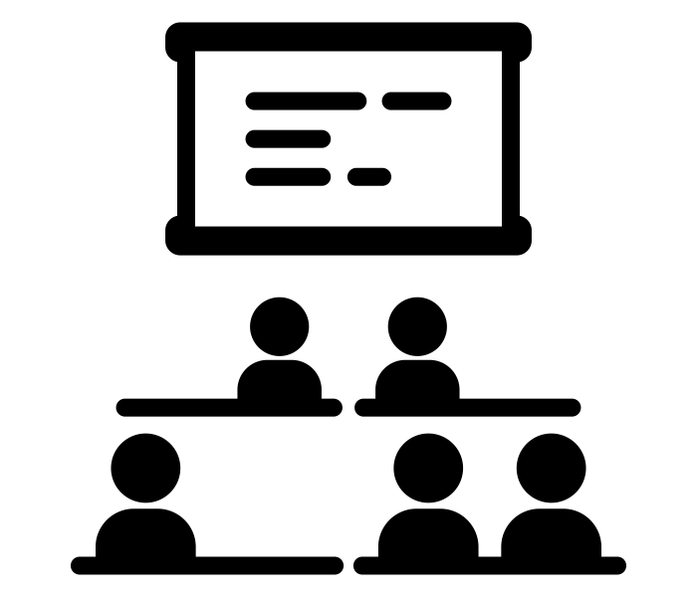

Reading I, II, & III
Darlene Riley Triggs Room B4
Email – Darlene.RileyTriggs@fortbendisd.gov
Syllabus
Goal: To increase students’ vocabulary, build their critical thinking skills, and increase their repertoire of reading strategies to not only pass the English STAAR exam but ANY exam.
Materials
These are items that you will be using in class most days
Interactive Notebook: OneNote
Pen or Pencil
Current Unit Text
Independent Reading Book
Vocabulary text
Units
Floating Units will be integrated throughout the semester and will build on skills in primary units
Reading units will be flexible and meet the needs of the individual student. Although paired and small group activities will be encouraged and utilized often, some students will work independently to build his/her reading abilities.
Vocabulary is the key to reading comprehension, so emphasis will be placed on vocabulary. As such, vocabulary will be pre-taught before tackling a reading passage. Additionally, students will use graphic organizers to assist with the reading comprehension.
Test taking skills will be a core focal point of every reading unit. So, please come to class ready to engage in all activities.
Schoology Reminders
Notifications turned ON
Always hit SUBMIT on assignments
Check for Daily Agenda / Upcoming Assignments
Absences and Makeup Work
If you are absent from class, YOU are responsible for getting and making up any missing work
    See me during conference time, 7th period - not during class - to get help, ask questions about missing work, or make up tests/quizzes
    Work from Schoology (posts of work)
    You will have an extension equal to the days that you are absent to make up work
Late Work
Students have 5 days to submit late assignments with a mild penalty of 5 points off each day. After 5 days, students can submit late work for a maximum grade of 50%.
    Major Grade assignments have a 1-day grace period for late work submitted. After that, a 10-point deduction per day will be assessed. After the 3rd day past the due date ,the highest grade a student can earn is a 70.
Extensions may be considered to students who contact me before an assignment is due.

Slide 2



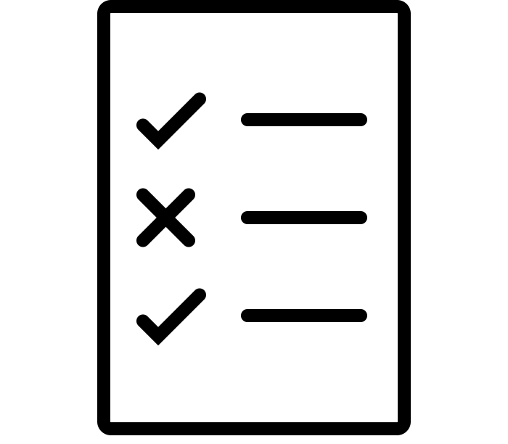


Procedures and Expectations
Be prepared
    Turn in assignments on time
    Check Schoology / Whiteboard for daily tasks
Participate in class daily
    Work hard
    Ask questions
    Limit distractions (including with technology)
Be respectful and understanding of classmates and me
    Listen when others are speaking
    Conduct yourself appropriately
Consequences
If a student chooses not to meet these expectations, the following consequences will be followed:
Verbal Warning
Parent Contact
Administrative Referral
Additional Policies
Class Cell Phone Policy
Cell phones are NOT to be seen in class. Cell phones can only be used before and after school and during lunch.
If your cell phone is visible, I will first ASK for you to put it away – in your backpack. If you do NOT put away your phone, your phone will be placed on my desk until the end of class. If you do NOT willing give me your phone, an administrator will be called to get your phone. If an administrator comes for your phone, your phone will not be released until your parent comes to get it.
If you have your phone out in class a 2nd time and do not willingly give it to me, an administrator will come to get your phone, and your parent will have to pay $15 to retrieve your phone.
It will be to YOUR benefit to keep your phone out of sight during class time.
The Beauty of Privileges
Music - Music may be listened to during independent work times ONLY WHEN PREMITTED and played by me, the teacher.
Food/Drinks - Students may have snacks or drinks in class only if you ask first, AND you are respectful of your area and clean up after yourself. This is a privilege and can be taken away if our classroom space is not respected ,and if this becomes a distraction.
Plagiarism
Just don’t. Seriously.
I expect your work to be original, and plagiarism will not be tolerated under any circumstances
You will receive a zero for any assignments that are plagiarized, a write up, and a parent contact.
Is it plagiarism? A quiz:
Did you, at any point, copy and paste it from the internet?
  A: Yes.
Is it someone else’s ideas that you reworded?
  A: Yes.
Did you take another student’s work and reword it?
  A: Yes

Slide 3
Additional Communication
Maturity
You are juniors. In one year, you are expected to leave the comfort of these walls and make your impact on the world. I want you to succeed in every aspect! To succeed, you know that rules must be followed, so adhere to them. Demonstrate your maturity. Be respectful. Keep your phones in your backpack. Participate in class, and ALWAYS come to class with your A-game!
Tutorials
I will be available for tutorials on Tuesday, 2:55 – 3:55pm.
Grading Policy
There will be a minimum of 9 grades 6 daily and 3 major per nine weeks. Please check grades frequently throughout the school year so you are consistenly aware of your progress and standing in this class.
Grading Scale:
Daily Grades= 50%
Major Grades= 50%
Laptops
Your laptops will be needed daily. Please ensure that you charge your laptop every night and bring your laptop and charger to class every day!
Work will be posted in Schoology and other apps will be utilized daily, so it is imperative that you have your laptops DAILY!!
Your success depends on your preparation. Be PREPARED to work hard. Your efforts will be rewarded.
Let’s have an amazing year!
Classroom Behavior Expectations:
-Respect everyone present in the classroom.
-Be on time, prepared to learn, and with supplies.
-Follow instructions politely and promptly.
-Do your best.
-Never limit yourself; you can do more than you think you can!

Slide 4
COMPLETE, SIGN AND RETURN TO YOUR TEACHER
Student Full Name: __________________________________________________________
Parent Print Name & Signature _________________________________________________
Parent Email: __________________________________________________________ ________
Date Signed _____________________________________________________________

